Slide 1
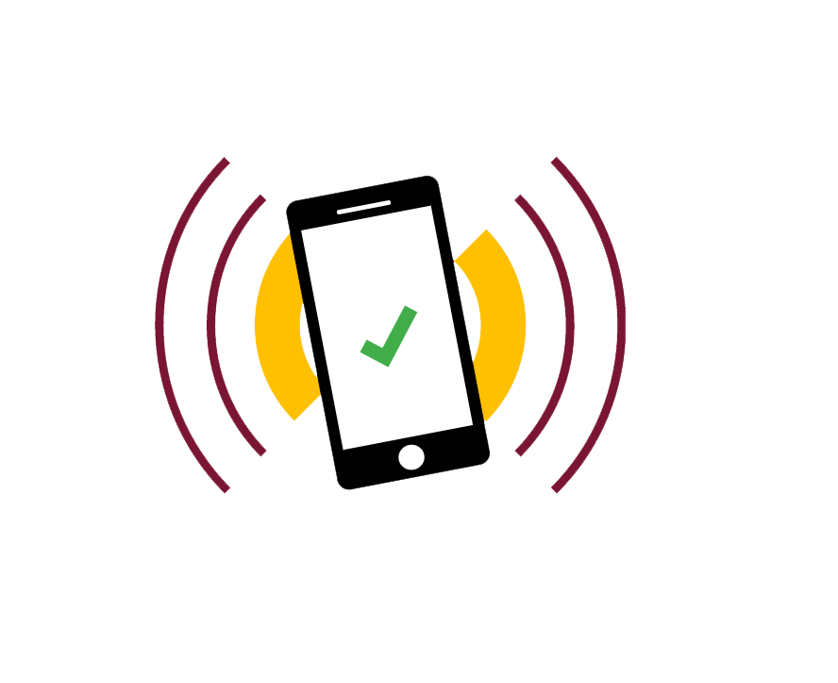
Prototype Presentation
App Name : TurnUp
Group Number : 27
Group Tutor : Simon Taylor
Group Members
Loredana Vadana
Shreyas Jain
Maedin Zekarias
Taqi Tazwar
Thomas Hunt
Mark Andrews
TurnUp

Slide 2
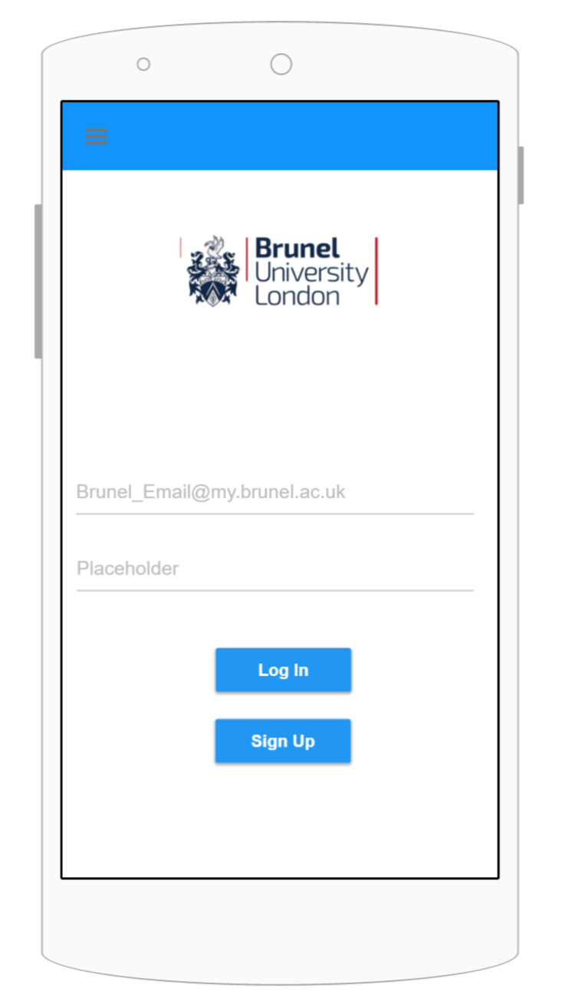
Log In Screen
User can enter their Brunel Email ID and Password
to Log In.
Log In button logs user in the application, which takes
User to home screen.
Sign Up button will take the user to sign up screen.

Slide 3
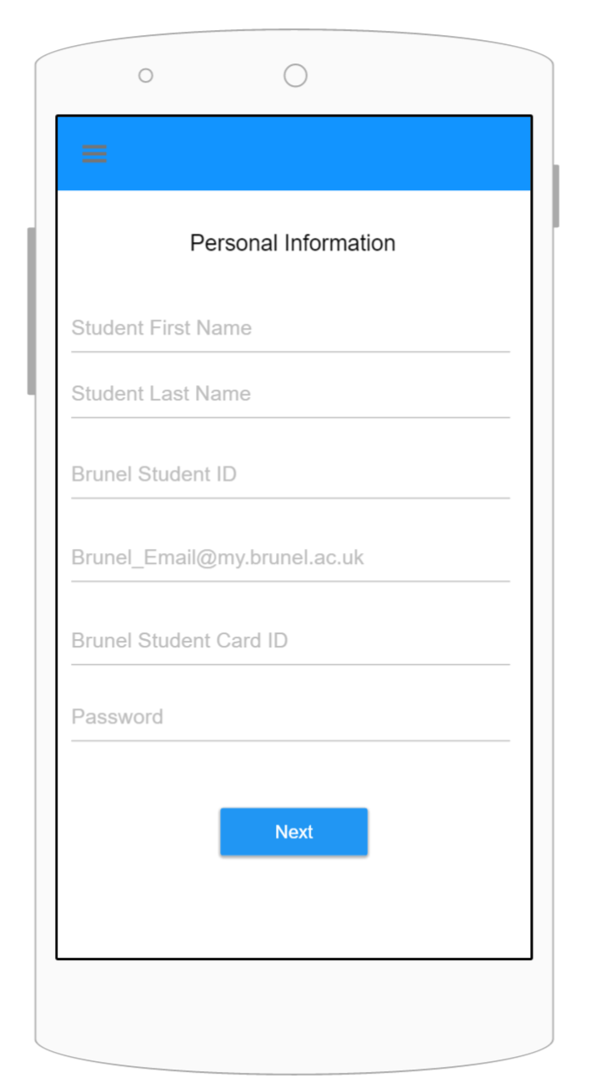
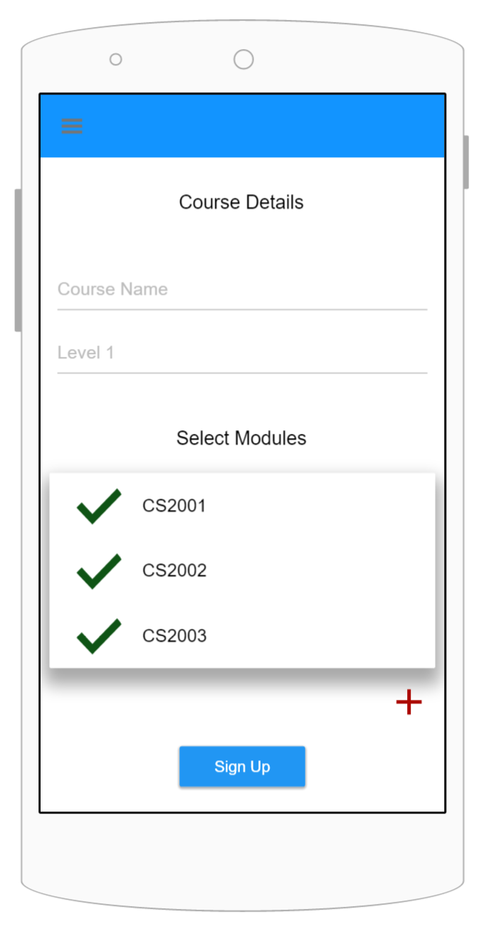
Sign Up Screen
User needs to enter the following to Sign up:
Student First Name
Student Second Name
Brunel Student ID
Brunel Email ID
Brunel Student Card ID
Password
Course Name
Level of the Course
Module Codes
Next button will take user to second page.
Sign Up button will register the user account,
And take the user to Log In screen.

Slide 4
Home Screen
Home screen lets you select the module you want to
register and then user taps the phone on the NFC chip.
User can swipe from right to left to go to time table screen.
User can swipe from left to right to go to history screen.

Slide 5
Time Table / Upcoming Lecture Screen
The time table screen opens when user swipes from right to left on the home screen.
To go back to home screen user can swipe from left to right.
The time table / upcoming lecture screen lets user see the upcoming lecture and the details of the lecture when user taps on the module.

Slide 6
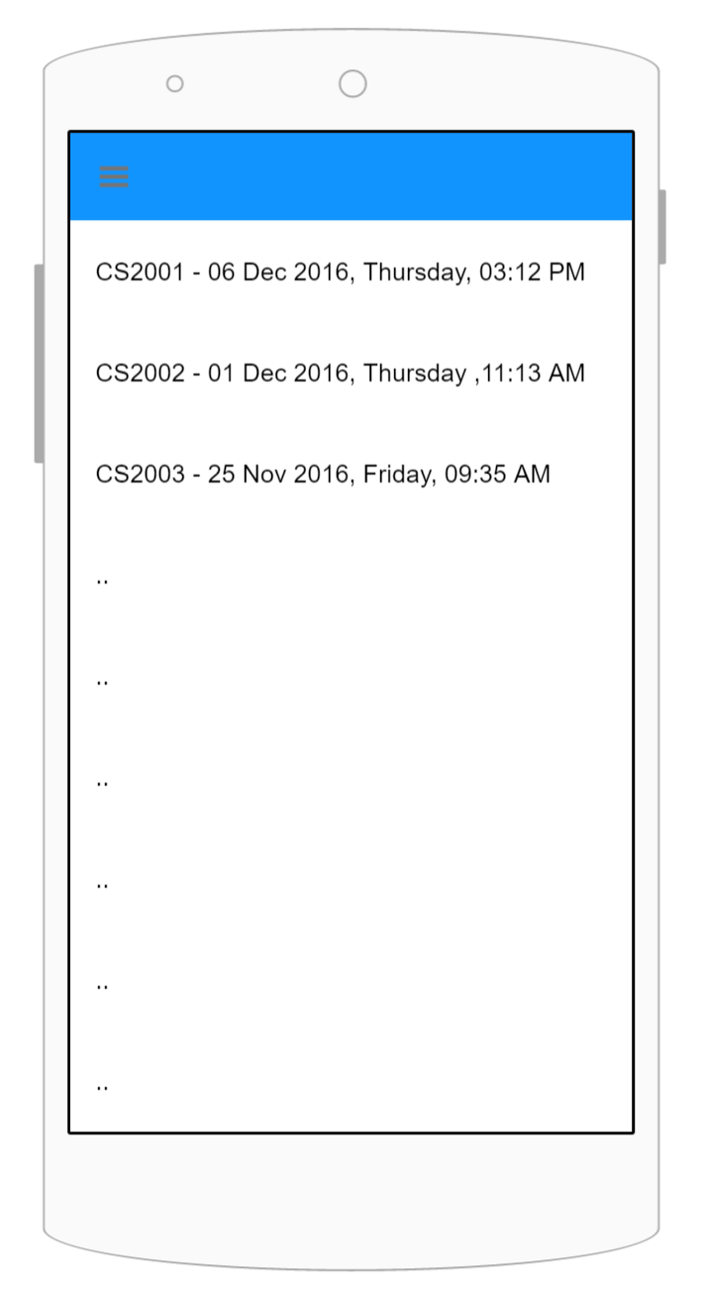
History Screen
User can swipe from left to right on the home screen to
get to the history screen.
To go back to home screen, user can swipe from right to left.
History screen shows all the lecturers student attended with
Module code, date, day and time.

Slide 7
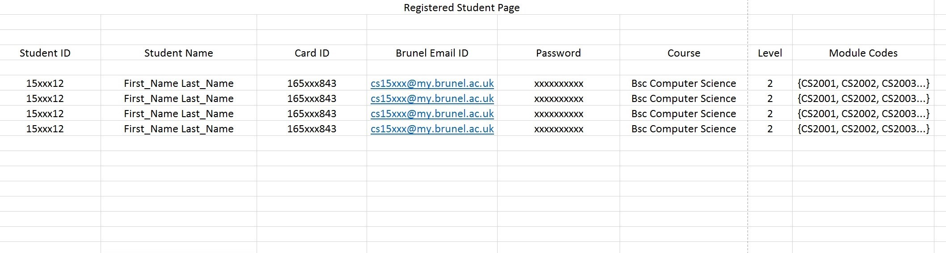
Database (Registered Student Page)
All the student details are stored in this server page after user registers.

Slide 8
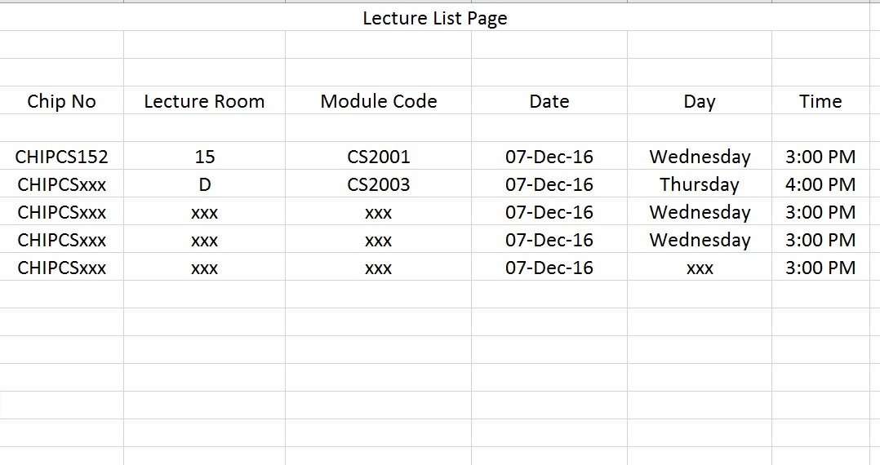
Database (Lecture List Page)
All the lecture details are stored on this page to verify the lecture when student registers.

Slide 9
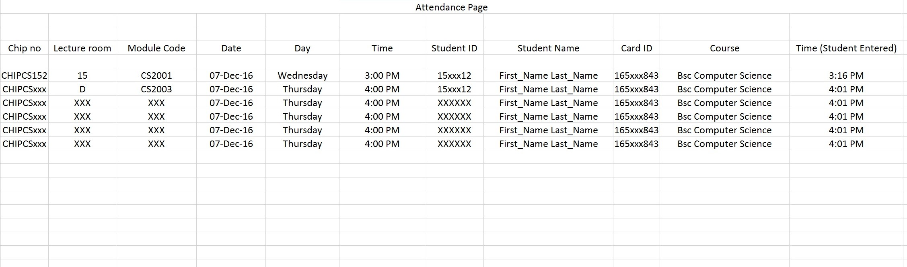
Database (Attendance Page)
This is the attendance page where all the attended students information and lecture information is stored.

Slide 10
Thank You!
TurnUp

